Slide 1
Predicting nba results based on common basketball statistics
ANTONIO BALSEIRO VILELA
JUNE 2021

Slide 2
INTRODUCTION
Predicting the number of wins teamS obtain durng a given season can help to foresee performance in future scenarios
Teams (and investors) can Benefit from knowing past performances
Fans might also have interest due to the current fantasy leagues

Slide 3
DATA
PLAYERS STTISTICAL PERFORMANCE FROM THE 2020-2021 REGULAR SEASON
TEAM WINS OBTAINED BY EACH TEAM
DATA WAS CLEANED, TRAINED AND TESTED
Initial dataset contained 500 rows and 30 features
Final dataset contained 30 rows and 12 features

Slide 4
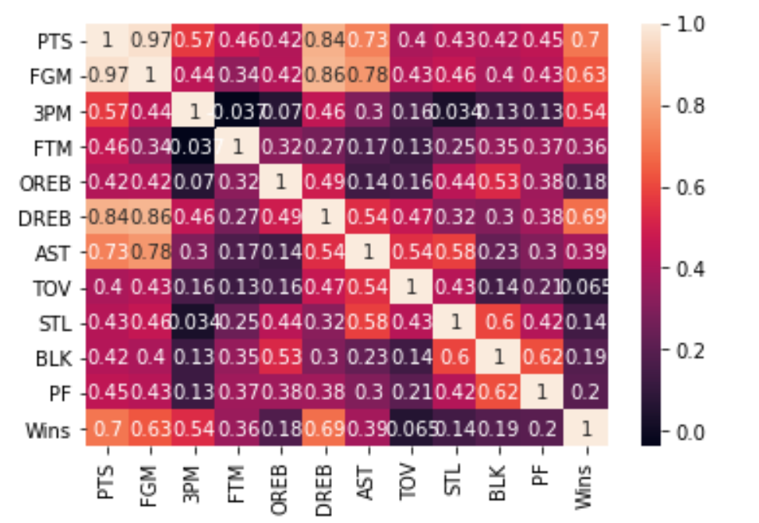
CORRELATION ANALYSIS
correlation matrix to quantify the degree to which two variables are related

Slide 5
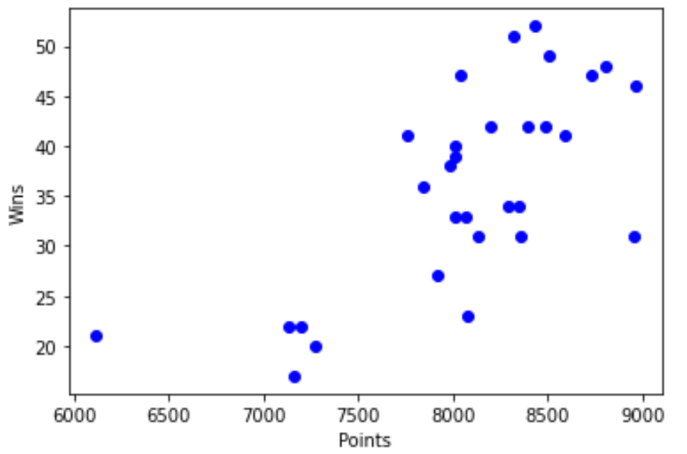
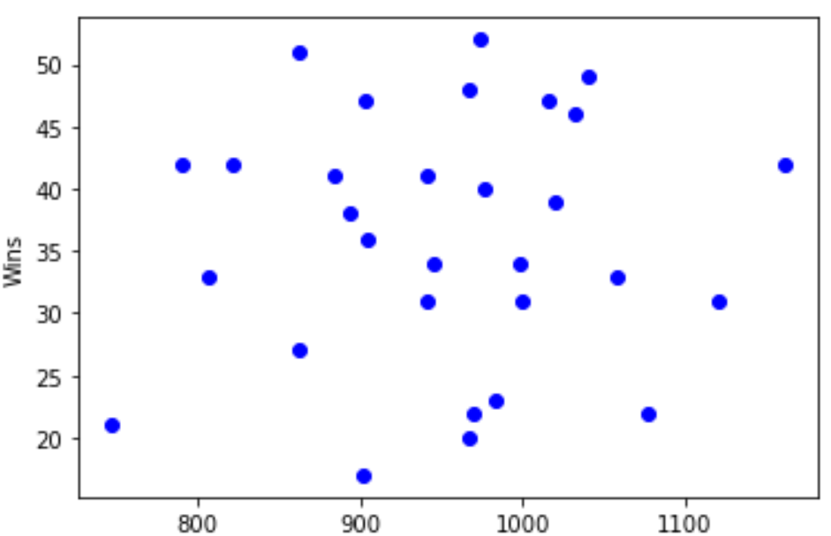
SCATTERPLOT TESTING
HIGH CORRELATION
LOW CORRELATION

Slide 6
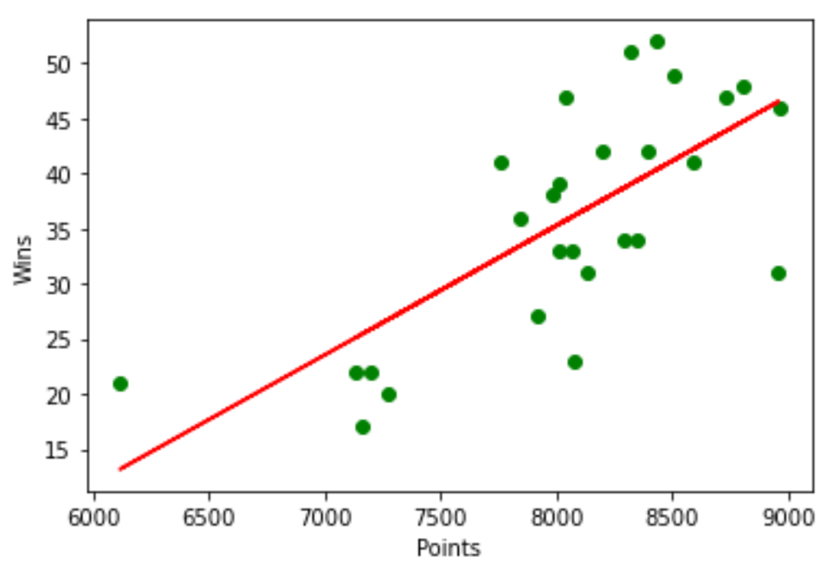

SIMPLE AND MULTIPLE LINEAR REGRESSION MODEL
Linear correlation between wins and points
N SIMPLE LINEAR REGRESSION MODEL IS NOT ENOUGH TO PERFORM SUCH AN ANALYSIS

Slide 7
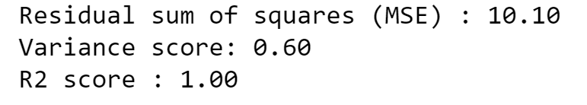
RESULTS OF LINEAR MULTIPLE REGRESSION MODEL
the variables chosen do, in fact, explain the number of wins that each team obtained by the end of the Regular Season

Slide 8
FLAWS OF THE MODEL
SMALL SAMPLE SIZE
SMALL NUMBER OF STATISTICS TESTED
NOT ADVANCED STATITISCS TESTED
INTANGIBLE FACTORS NOT TAKEN INTO ACCOUNT, SUCH AS PLAYERS PERSONAL LIFE OR MENTALITY
INJURIES PLAY A BIG PART IN ALL SPORTS

